Slide 1
IT Service Desk – Project Plan
Idea
This application will work as IT customer care centre services, it will help the customers to contact IT department easily and quickly using this app.
If the customers have any problems in their PCs or if they want to order anything they need from IT Department , so they will open a new ticket using this app, once the ticket has been created then IT Department will contact the customers as per the ticket’s priority to get their issues sorted out.
The customer will open new task ( incident or order ) by themselves and the app will ask many questions to figure out what is the customers looking for, then the app will assign the priority, then the app will tell the customer: when the IT person will contact them to get the customer’s issue sorted out.

Slide 2

Requirements
In this program we will use 4 classes as well as the Main program.
Employee
Ticket
Incident
Order

Slide 3
Main diagram ( main program with classes)
Class
Employee
Program.cs
Ticket
Class
Class
Order
Incident
Class

Slide 4
Employee
Class
In this class designed to ask the customers in enter their contact details (ID, First Name, Last Name,……etc.)
Ticket
Class
Parent class (base class)
Both classes Incident and Order will be as child classes, inherits from ticket class.
Incident
Class
Child class based on Ticket.
This class has been designed to ask the customers about what kind of issues happened to get them sorted out.
Order
Class
Child class based on Ticket.
This class designed to ask the customers about what they would like to order.

Slide 5
Design(Data)
The main data that we need to be saved or printed out are below:-
Contact Details (ID, First Name, Last Name, Phone, Email)
How many Tickets, Incidents and Orders has been created.
How many Tickets has been created with P1, P2, P3, P5.
Incident/Order Details.
Incident/Order Number(random number)

Slide 6

Design (code)

Slide 7
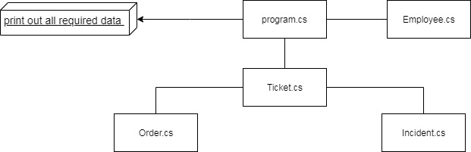
As I mentioned before that we need below:-
program.cs(main)
Employee.cs (class)
Ticket.cs(base class)
Incident.cs(child class)
Order.cs(child class)

Slide 8
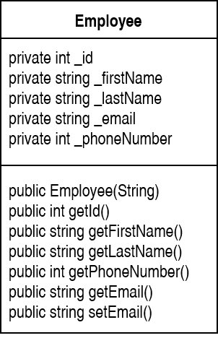
Employee.cs
This class designed to get the Customers Contact Details:
ID
First Name
Last Name
Phone
Email
Then print them out once the customer created a Ticket.

Slide 9
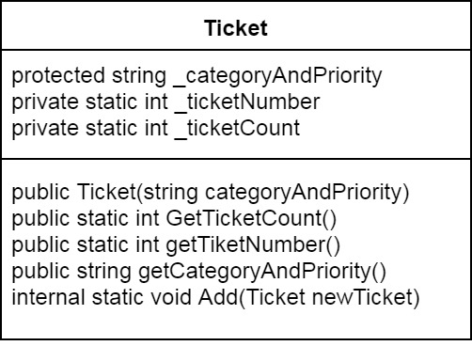
Ticket.cs
In this class we will make below basic things:
Main constructor: will be used to assign the Incident Category with Priority and the Order Category also by using String via main program.
Providing Incident/Order Numbers (Ticket Number).
The Ticket counter will be increased once the customer created new Ticket (Incident or Order).
Counter : to know how many ticket has been created.

Slide 10
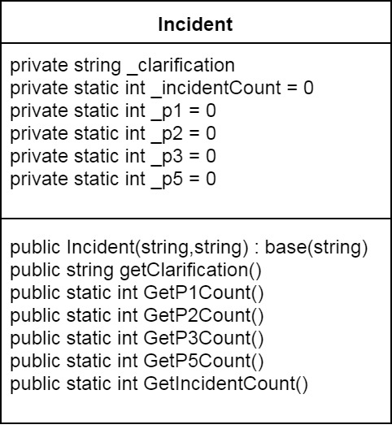
Incident.cs
In this child class the constructor will build to string clarification by customers and string category with priority based on Ticket class.
The Incident counter will be increased once the customer decided to create new Incident.
The priority will be assigned regarding to Ticket class (getCategoryAndPriority)
The Priority counters will be used to know that how many Incident has been created with P1, P2…..etc.

Slide 11
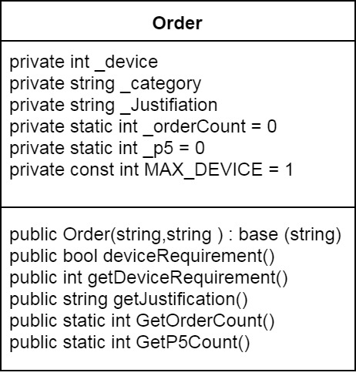
Order.cs
In this class the constructor will be designed to string Justification by customers, and the category will be assigned based on Ticket class.
The counter will be increased once the customer created new order.
Here we have only P5 because it is hardware issue.
We will make setter here to let the customer order only one device (Laptop or Monitor….etc.)

Slide 12
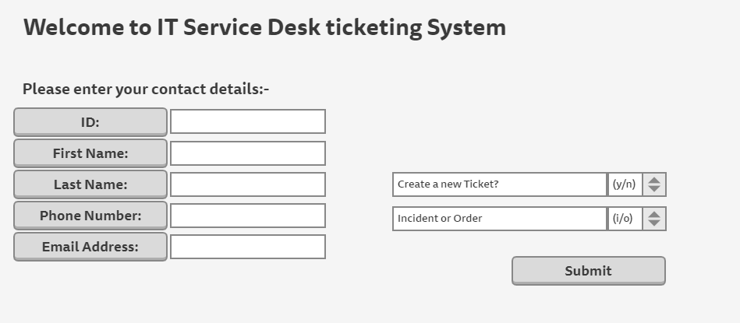
UL (How is the app going to look like?)

Slide 13
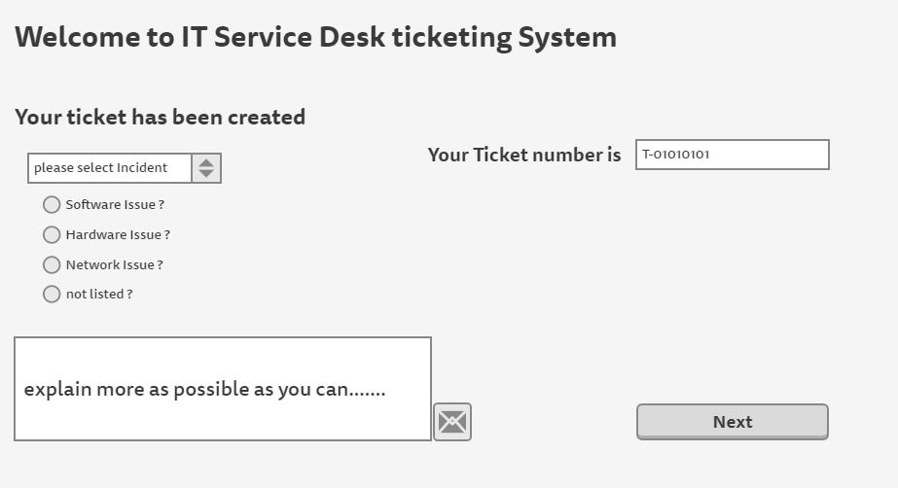
UL (How is the app going to look like?)

Slide 14
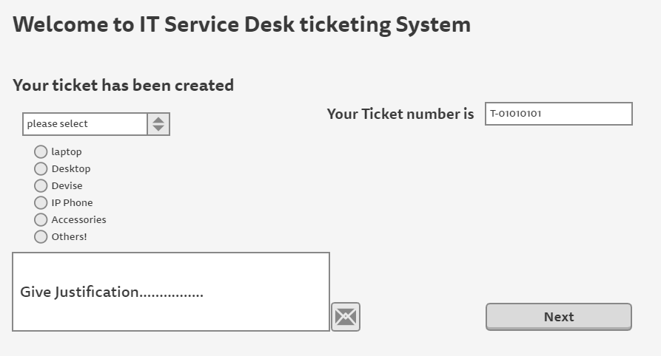
UL (How is the app going to look like?)

Slide 15
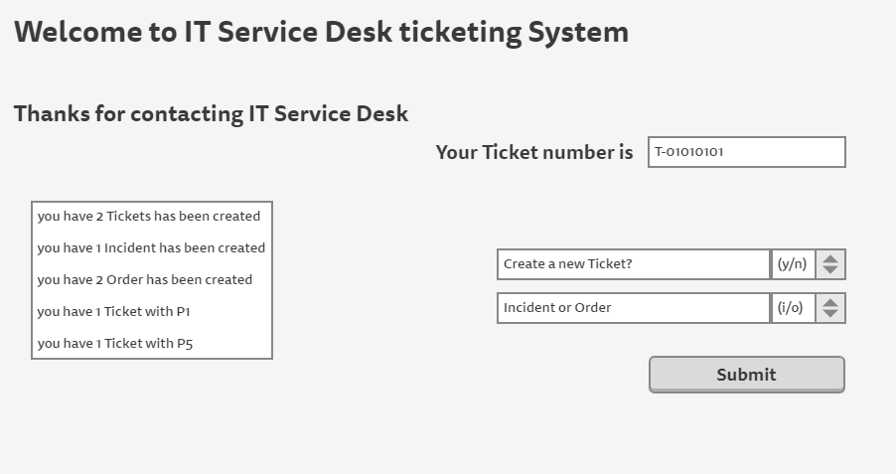
UL (How is the app going to look like?)

Slide 16
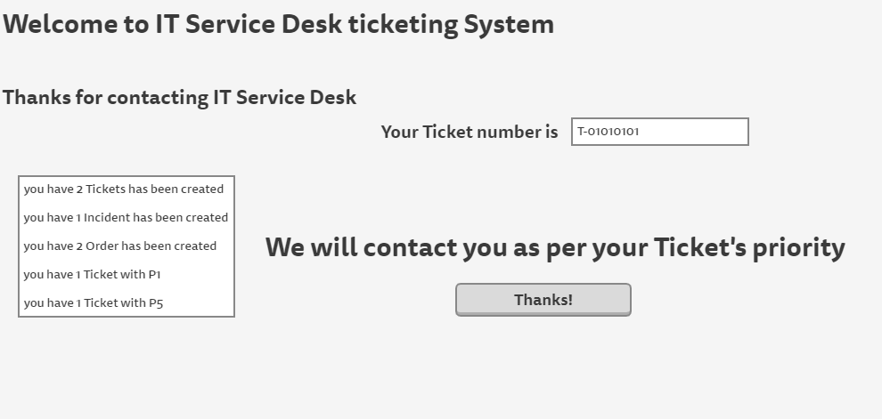
UL (How is the app going to look like?)

